Slide 1
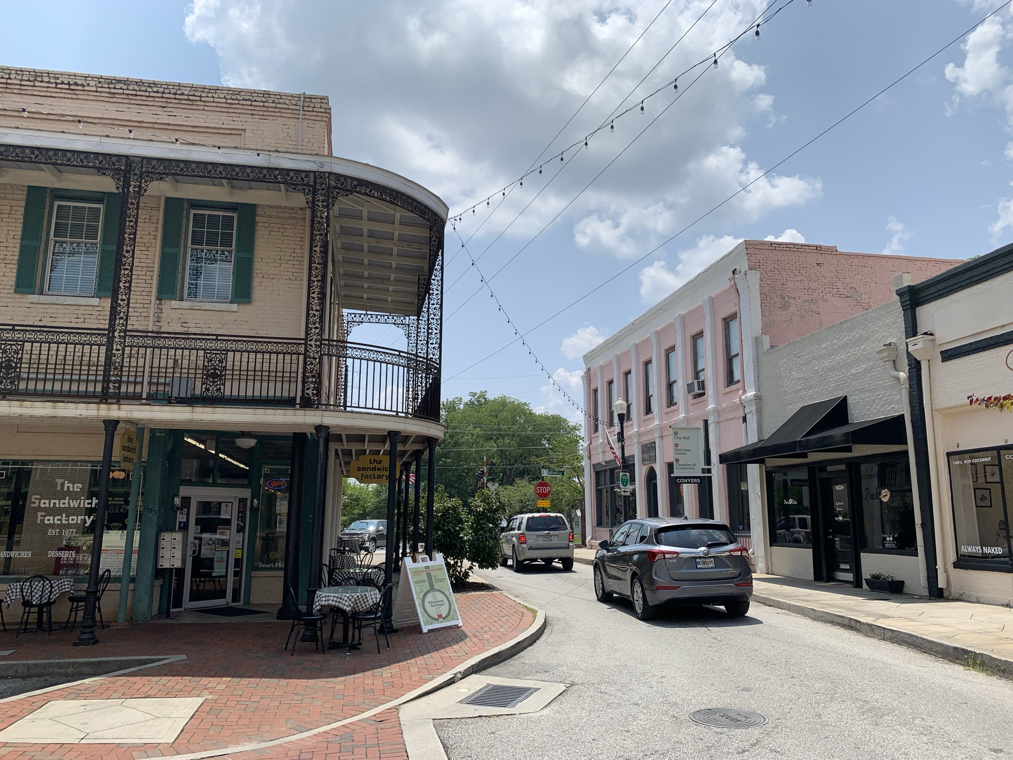

ROCKDALE COUNTY
TRANSIT DEVELOPMENT PLAN
Conyers City Council Meeting
December 7, 2022

Slide 2
Today’s Presentation
What is a Transit Development Plan?
Benefits of Public Transit
How Can I Get Involved?
Q&A
2

Slide 3
What is a Transit Development Plan?
3

Slide 4
Rockdale County Transit Development Plan
30-Year Plan
Transit Vision
Short-, mid-, and long-term recommendations
Financial Considerations
TRANSIT DEVELOPMENT PLAN
4
Notes:
Grady
30-year plan
Transit vision
Short-, mid-, and long-range recommendations
Fare policy
Financial considerations
Rebranding

Slide 5
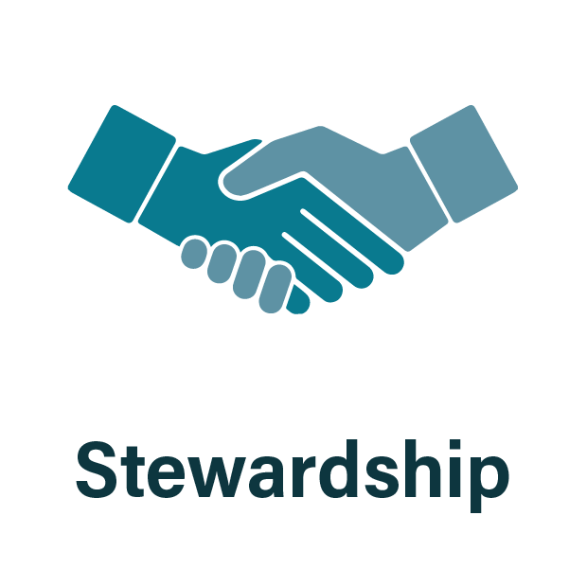

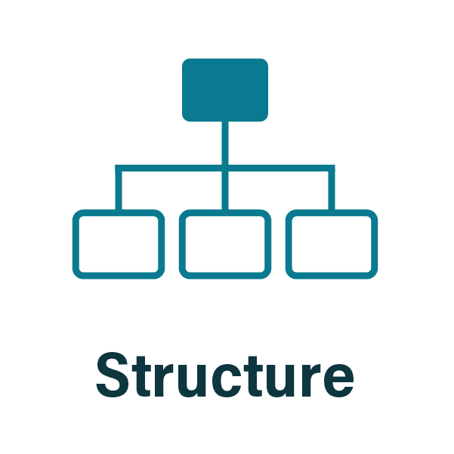

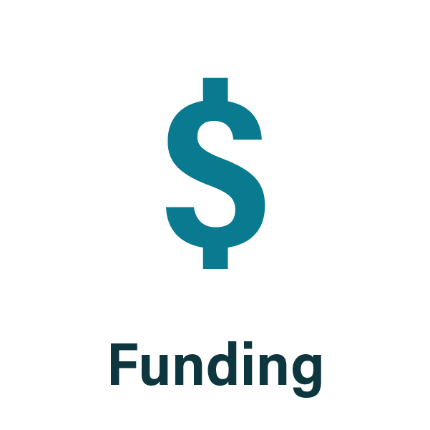
Goals
5
Notes:
Grady

Slide 6








Need for TMP
Population + Employment Growth
Input for Atlanta Regional Transit Plan
Changing Finances
Why do we need a TMP?
SPLOST & T-SPLOST
Meet Unmet Demand (Pre-COVID)
Peers are offering fixed route services
Acceptance of
Transit
6
Notes:
Counties in the Metro Atlanta region (designated nonattainment area: currently consisting of Cherokee, Clayton, Coweta, Cobb, DeKalb, Douglas, Fayette, Forsyth, Fulton, Gwinnett, Henry, Paulding, and Rockdale counties) have the option to levy a Transit SPLOST. • Levied up to 1 percent in .05 percent for up to 30 years. • 'Transit projects' means and includes purposes to establish, enhance, operate, and maintain, or improve access to transit… • ATL Authority approves or denies any or all projects. • Any county outside of the Metro Atlanta region which partners with a neighboring county can call for a referendum to levy a Transit SPLOST up to 1% (and may be in .05% increments) for up to 30 years. Unless the referendum is approved in each of the participating counties, the tax shall not be imposed.

Slide 7

Transit Development Plan
WE ARE HERE
Prioritize Needs into Short-term, Medium-term and Long-term plans
Existing & Future Conditions
Identify
Needs
Technical Work
Develop financial plan
Transit
Development
Plan
INFORM
INFORM
INFORM
Technical Committee
Technical Committee
Technical Committee
Engagement
Stakeholders
Stakeholders
Stakeholders
Public
Public
Public
Elected Officials
Elected Officials
Elected Officials
7
Notes:
Grady
At the end of the day, we will have a Concise, locally supported plan with Short, mid, long-term transit strategies.
In line with funding opportunities at local, state, federal, private levels
Focused action plan for all parties: Rockdale County, City of Stockbridge, City of McDonough, City of Hampton & City of Locust Grove

Slide 8
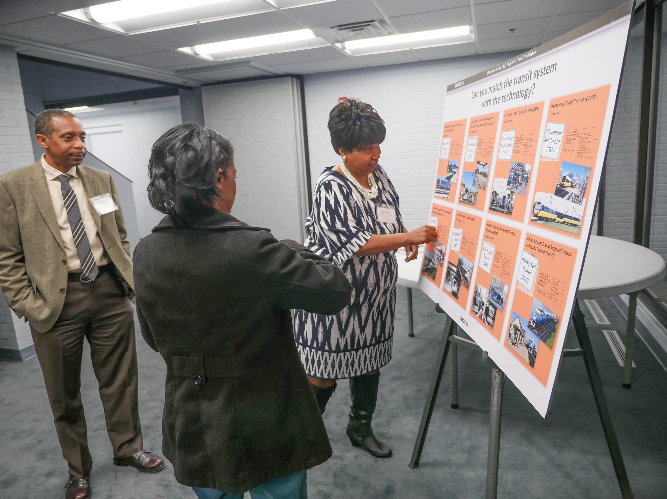
Outcomes
Concise, locally supported plan
Short, mid, long-term transit strategies
In line with funding opportunities
(local, state, federal, private)
Focused action plan
8

Slide 9
Benefits of Public Transit
9
Notes:
Laura

Slide 10
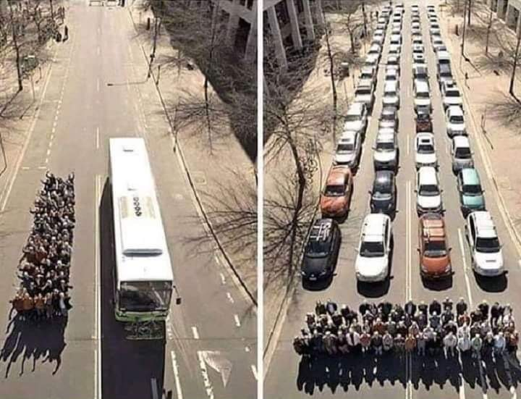
Benefits of Public Transportation
$1 investment in public transportation generates $4 in economic returns
Every $1 billion invested in public transportation supports 50,000 jobs
80% of Millennials say living near transit is “very important“
US transit saves 37 million metric tons of CO₂ annually
Households can save $10,000/year by eliminating one car
Transit can reduce congestion
Taking transit can reduce your chances of being in an automobile crash by 90%
Source: https://humantransit.org/2012/09/the-photo-that-explains-almost-everything.html
10
Notes:
Laura
https://www.apta.com/news-publications/public-transportation-benefits/
https://uspirg.org/blogs/blog/wap/millennials-want-more-public-transportation

Slide 11
How Can I Get Involved?
11
Notes:
Azy

Slide 12
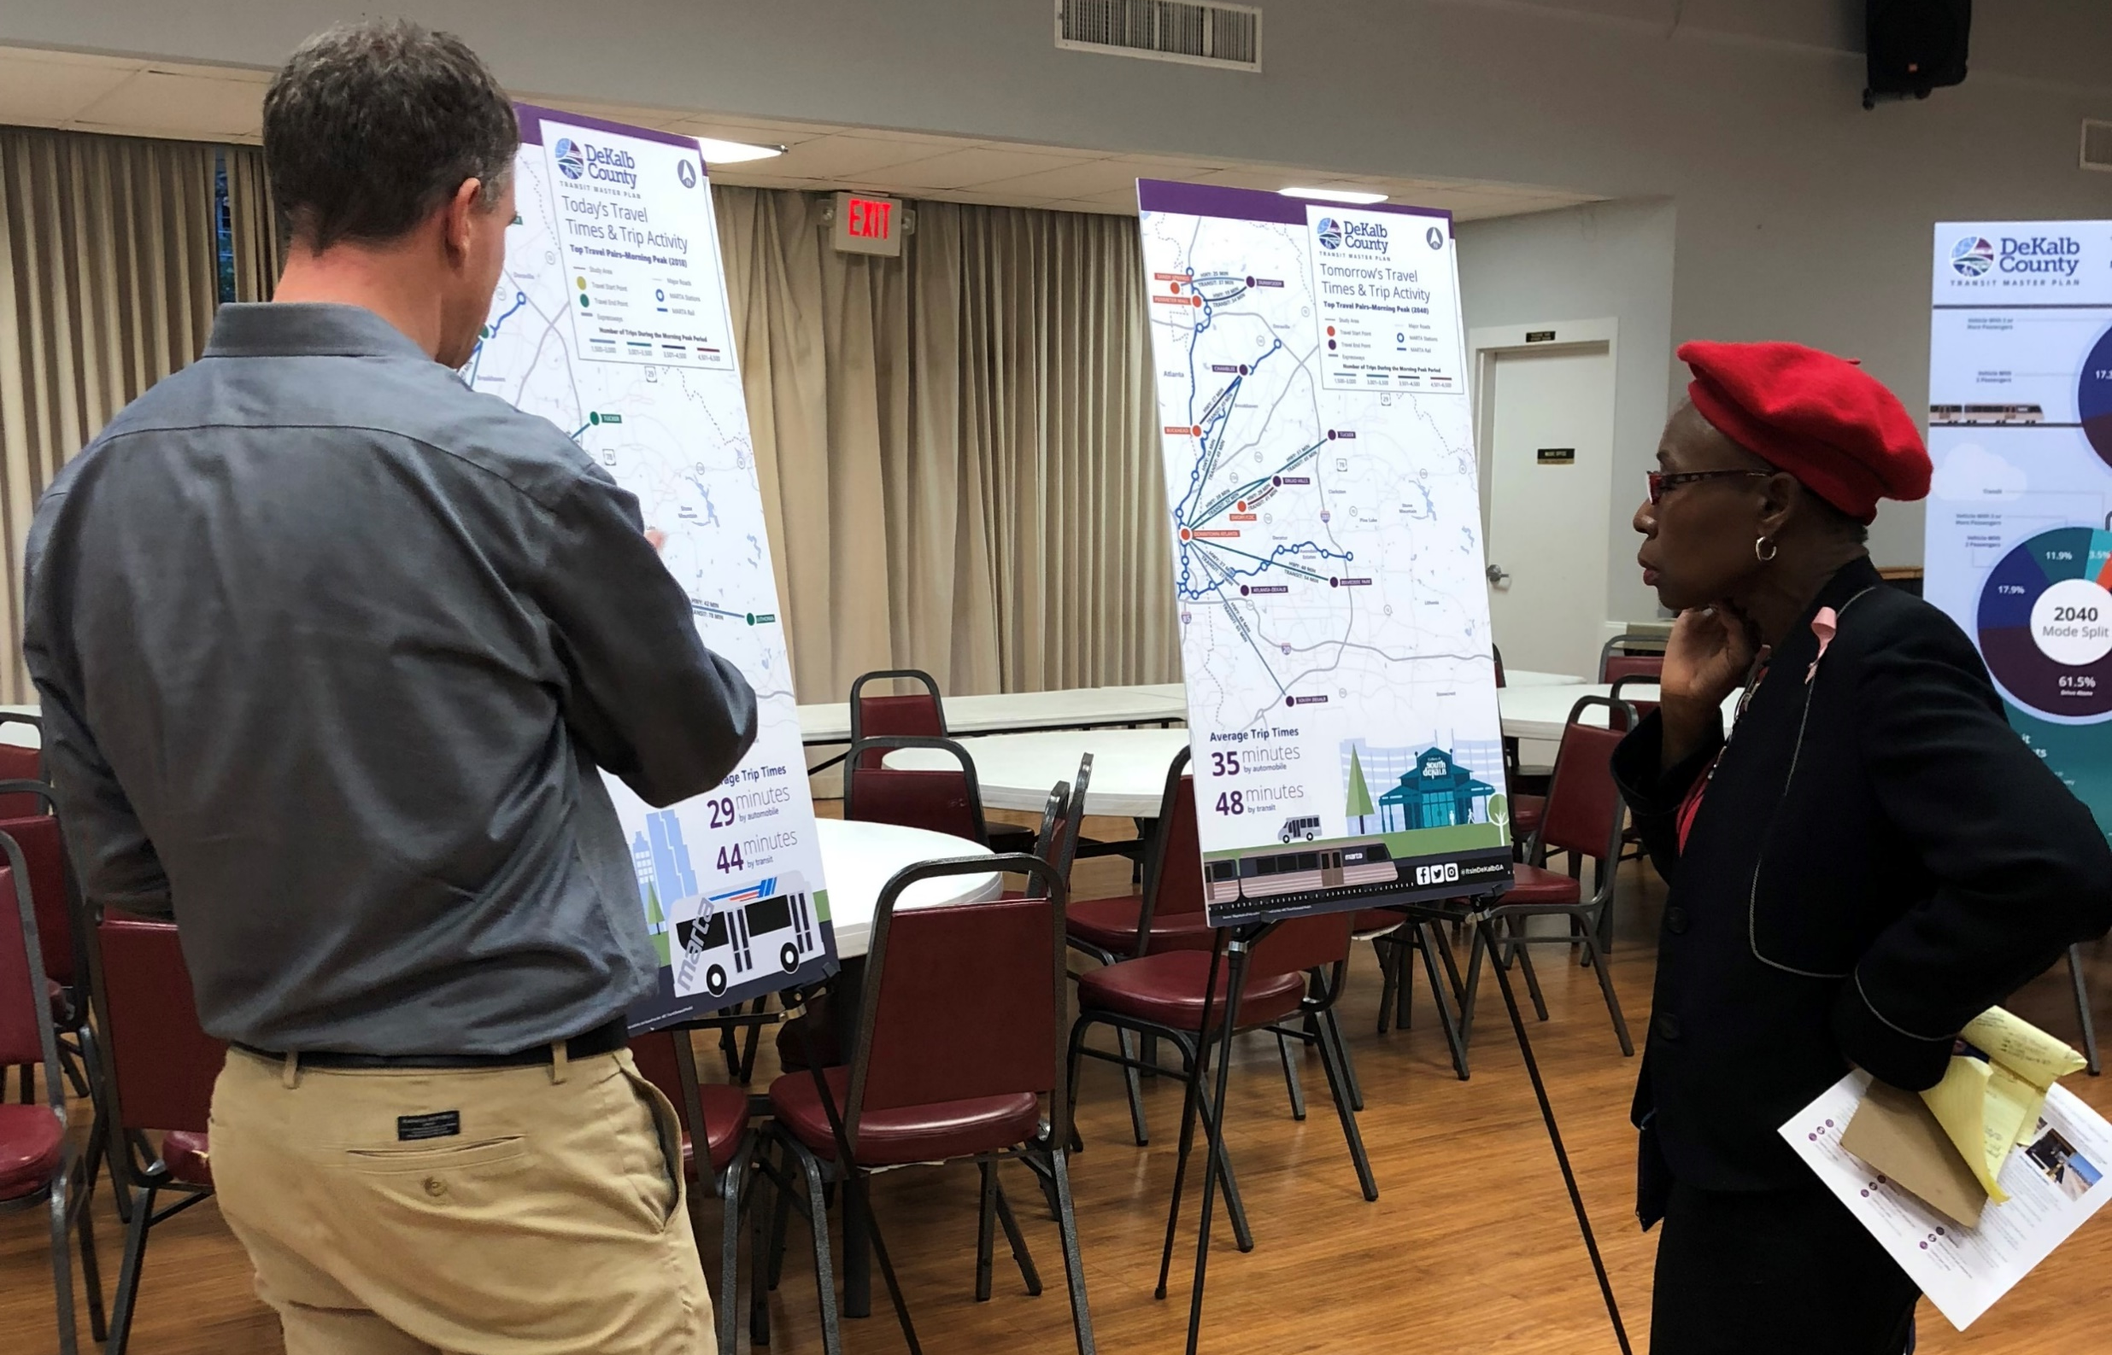
Public Involvement Activities
Public meetings
Social Media
E-blasts
Online surveys & polls
Project website
12
Notes:
Azy

Slide 13




Get the Word Out
Promote community
outreach events
Join & help promote our
email list
Visit our website
Follow Rockdale social media
13
Notes:
Azy

Slide 14
Questions & Answers
14
Notes:
Geilia to emcee

Slide 15
Thank You
15
Notes:
Tye

